Slide 1
Analyzing Flashcard Study Across an LMS
Learning Program Analysis

Slide 2
The Set-Up: Background &
Business Questions

Slide 3
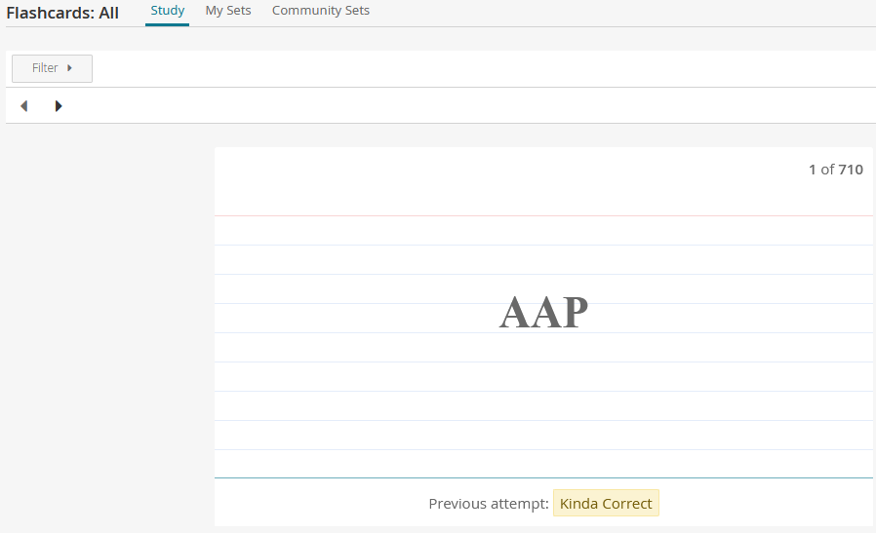
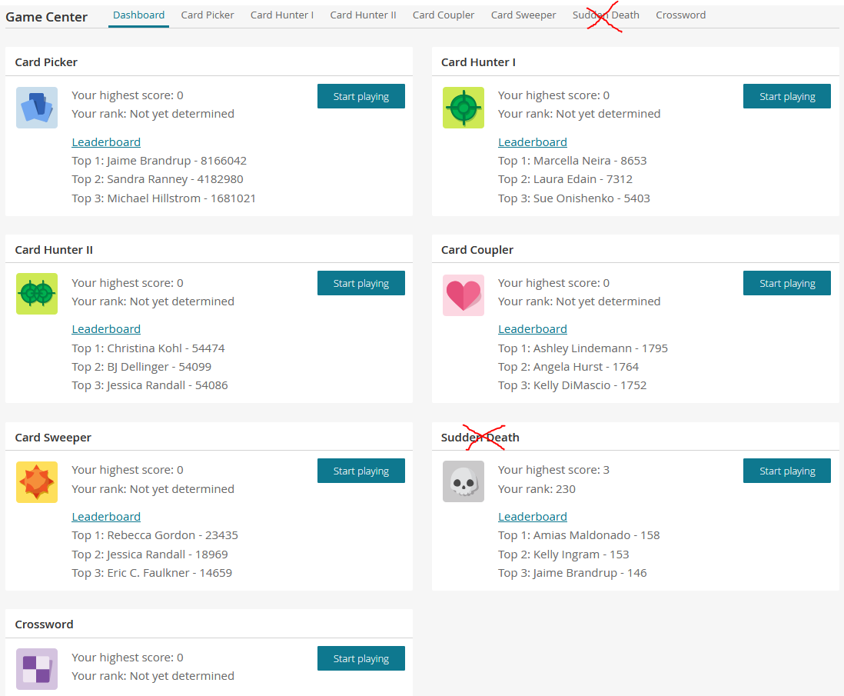
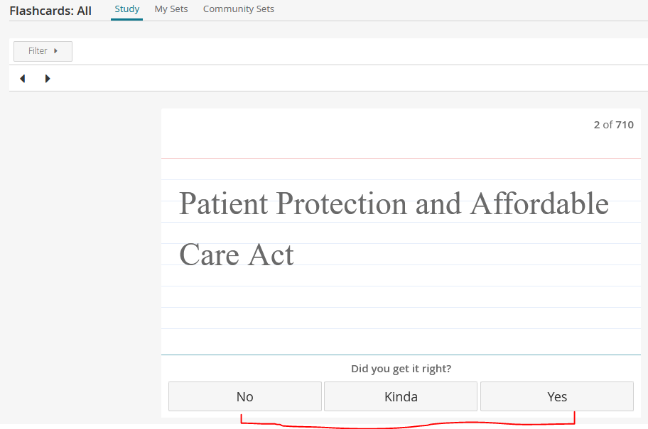
Background Information
Flashcards
Game Center
Notes:
See Appendix for more definitions, and Framing Business Questions to see my plan to analyze these 2 modalities.

Slide 4
Business Questions
Q1: Does Flashcard volume & usage impact Game Center engagement?
Q2: Does Game Center engagement impact learner confidence in flashcard study?

Slide 5
How to Investigate?

Slide 6
Investigating Q1
Does Flashcard volume & usage impact Game Center engagement?
Examine:
Flashcard counts, Confidence ratings
vs.
Game Center total highscores, total highscore achievements, and average highscore per course, flashcard game flip milestones

Slide 7
Investigating Q2
Does Game Center engagement impact learner confidence in flashcard study?
Examine:
Game Center total highscores, total highscore achievements, and average highscore per course, flashcard game flip milestones
vs.
% Low Confidence ratings on flashcards

Slide 8
“Does Flashcard volume & usage impact Game Center engagement?”
Q1 Findings

Slide 9
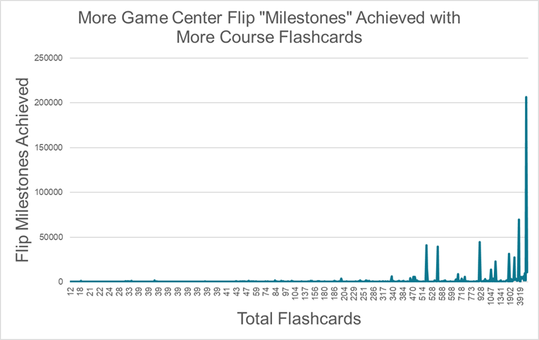
Notes:
Larger flashcard counts per course correlate with more Game Center engagement.
It looks like flashcard counts starting around 340/350+ starts having an impact. There do seem to be other underlying factors contributing as well.

Slide 10
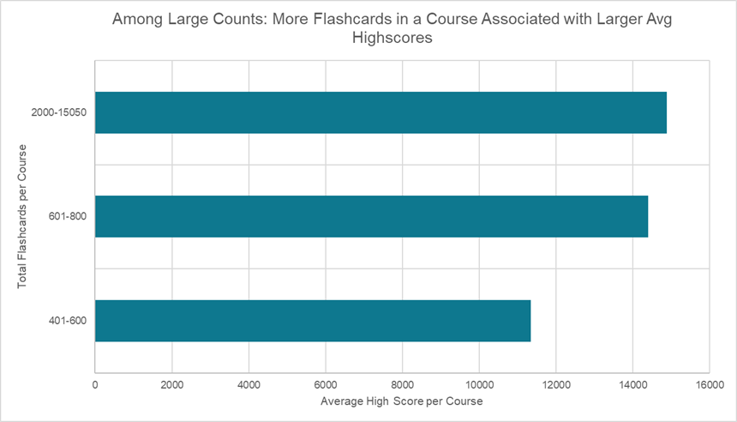
Notes:
Larger flashcard counts per course correlate with more Game Center engagement (avg Highscore in each course)
Having more flashcards in a course sets the Game Center up for success.

Slide 11
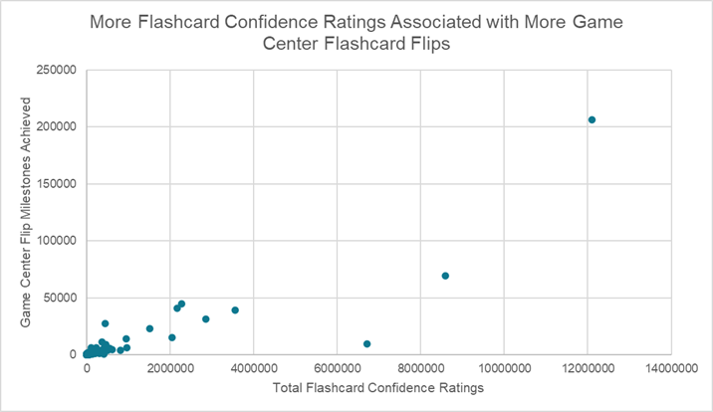
Notes:
High engagement with flashcard confidence ratings (agnostic of which confidence rating was used) come along with high Game Center engagement.
Next Step: Look into that outlier around 7M confidence ratings + 8k game center flip milestones to explore underlying factors.

Slide 12
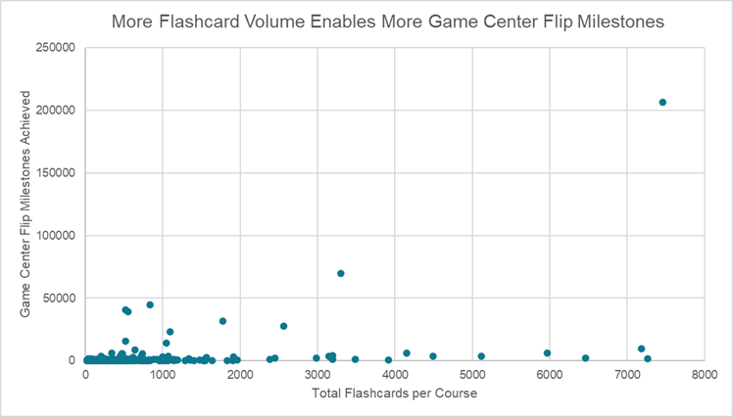
Notes:
Around 400 flashcards, the # of Game Center Flip Milestones in courses experiences a sort of “breakout” (beyond that flashcard volume, more game center flip milestones are achievable..
At around 300-400+ flashcards per course → better odds of higher game Highscores and more card game flip milestones.

Slide 13
“Does Game Center engagement impact learner confidence in flashcard study?”
Q2 Findings

Slide 14
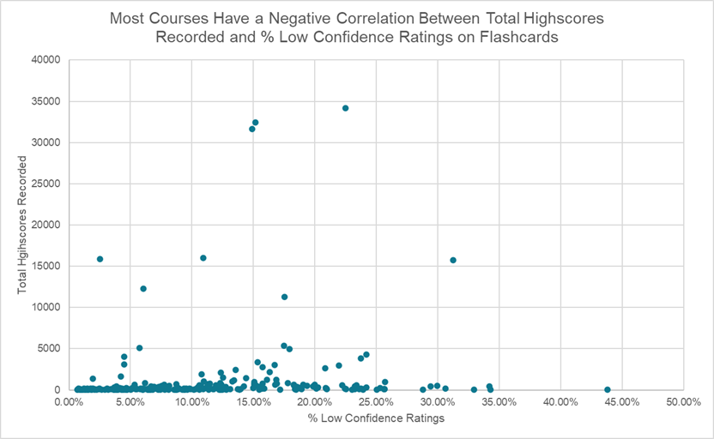
Notes:
Next Step: Investigate those few courses (in brackets) with unusually large % low confidence ratings for their total Highscore counts.

Slide 15
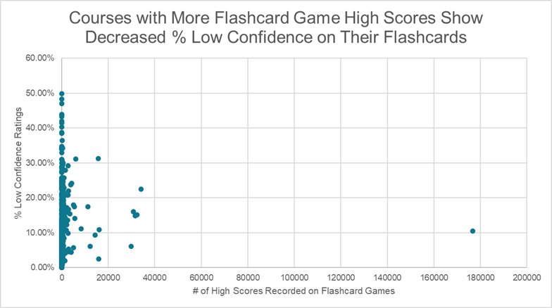
Notes:
At around 500-600 game highscores, the # of percent low confidence ratings looks “capped” at that low-30% level.
Next Step: Look closely into factors that could explain the VERY large # of highscores on the flashcard games, especially as it seems to be keeping the % low confidence ratings down (i.e., about 90% of learners have medium or high confidence in the course flashcards)

Slide 16
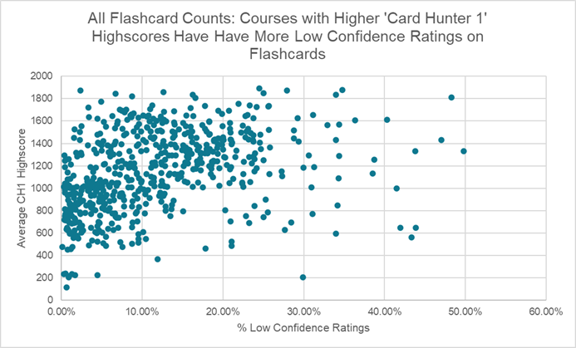
Notes:
Different games, different results: Highscore values on ‘Card Hunter 1’ are less associated with high flashcard confidence, while ‘Crossword’ and ‘Card Picker’ highscore values appear correlated to high confidence.
Next Step: Look more into causality of each flashcard game’s impact on confidence ratings
Compare confidence ratings in courses with different ‘Flashcard Addict’ vs. ‘Flashcard Player’ populations
A few very enthusiastic game players could be interfering with data?

Slide 17
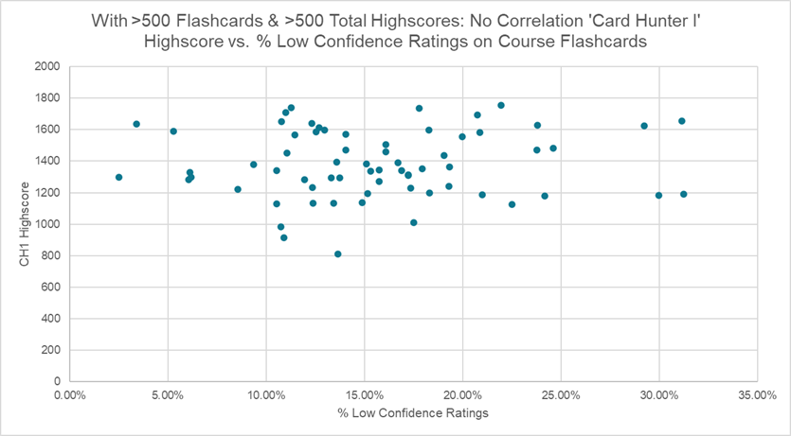
Notes:
Different games, different results: Highscore values on ‘Card Hunter 1’ are less associated with high flashcard confidence, while ‘Crossword’ and ‘Card Picker’ highscore values appear correlated to high confidence.
Next Step: Look more into causality of each flashcard game’s impact on confidence ratings
Compare confidence ratings in courses with different ‘Flashcard Addict’ vs. ‘Flashcard Player’ populations
A few very enthusiastic game players could be interfering with data?

Slide 18
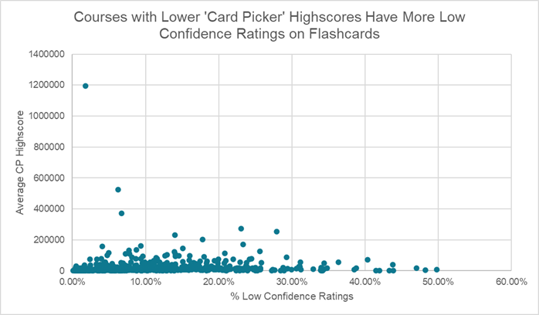
Notes:
Different games, different results: Highscore values on ‘Card Hunter 1’ are less associated with high flashcard confidence, while ‘Crossword’ and ‘Card Picker’ highscore values appear correlated to high confidence.
Next Step: Look more into causality of each flashcard game’s impact on confidence ratings
Compare confidence ratings in courses with different ‘Flashcard Addict’ vs. ‘Flashcard Player’ populations
A few very enthusiastic game players could be interfering with data?
Recommendation: Encourage Game Center engagement to support Flashcard mastery, especially on select games.

Slide 19
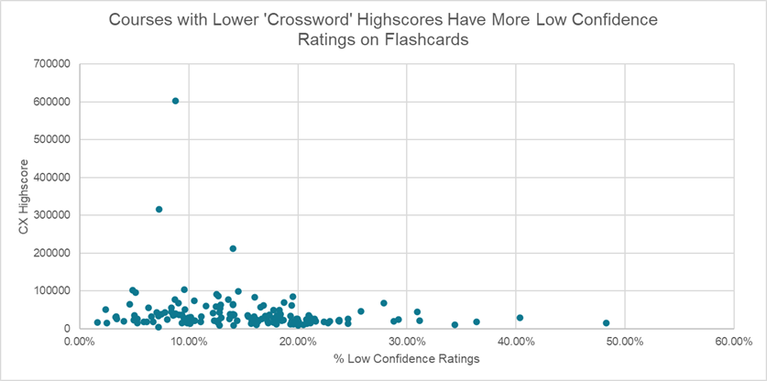
Notes:
Different games, different results: Highscore values on ‘Card Hunter 1’ are less associated with high flashcard confidence, while ‘Crossword’ and ‘Card Picker’ highscore values appear correlated to high confidence.
Next Step: Look more into causality of each flashcard game’s impact on confidence ratings
Compare confidence ratings in courses with different ‘Flashcard Addict’ vs. ‘Flashcard Player’ populations
A few very enthusiastic game players could be interfering with data?
Recommendation: Encourage Game Center engagement to support Flashcard mastery, especially on select games.

Slide 20
Conclusions & Next Steps

Slide 21
Observations & Conclusions
More Highscores and other engagement on games correlate to higher confidence ratings on flashcards.
More flashcard confidence ratings correlate with more Game Center engagement.
More flashcards per course correlate with more Game Center engagement.
Different games, different results: ‘Crossword’ and ‘Card Picker’ Highscores correlate to high confidence, but Highscores from other games, like Card Hunter 1, show little to no correlation with learner flashcard confidence..
At around 300-400+ flashcards per course → better odds of higher game Highscores and more card game flip milestones.
At about 500-600 flashcard game Highscores, % low confidence on flashcards remains well below 35%
Notes:
Product & LXP Note: I tried to use Bookmarks as an indicator of Flashcard modality engagement and usage, but few Bookmarks on Flashcards exist, vs. many Bookmarks on Questions and Lessons!

Slide 22
Recommendations & Next Steps?
Recommendations
Provide at least 300 Flashcards for a robust Game Center experience.
Encourage Game Center engagement to support Flashcard mastery, especially on select games.
Pair the Flashcard and Game Center modalities together more during course design, product, and sales conversations.
Promote the Bookmark feature on Flashcards - it is underutilized!
Next Steps
Compare flashcard confidence level to the ‘upper-tier’ game flip milestones.
What is causing each flashcard game’s unique impact on confidence ratings?
This study analyzed ~500 courses spanning multiple market verticals, user personas, and industries. I’d like to segment courses by industry and learner demographic to compare flashcard and game engagement by course type and then repeat to tailor content recommendations to different business models and learner needs.
Notes:
A few very enthusiastic game players could be interfering with data?
Investigate those few courses with unusually large % low confidence ratings for their total Highscore counts.
Review the course with the outlier Highscore count on its flashcard games.

Slide 23
Part 2: A Deeper Analysis
(Visualizations by Tableau)
6/24/21

Slide 24
Problem Statement/Summary: In this analysis, I extended and deepened my analysis of Flashcard and Game Center engagement from Project 2 to investigate the following questions:
- What impact does a course’s industry/topic have on flashcard and Game Center engagement?
- What impact does a course’s learner demographic - have on flashcard and Game Center engagement?
- Is there a relationship between the number of flashcard enthusiasts (fka “flashcard game addicts”) to flashcard confidence level ratings across learner demographic or course topic?
Approach: Using industry expertise, I classified over 600 courses from our online learning platform with the industry/subject of their content and the learner demographic of their target audience. I then redid my analysis of flashcard and Game Center engagement, analyzing trends by these course demographics and content subject matter.
Audience: Internal stakeholders who make content and product decisions.
Background Information
Notes:
Analyzing Flashcard Low Confidence by course topic and learner demographic reveals trends

Slide 25
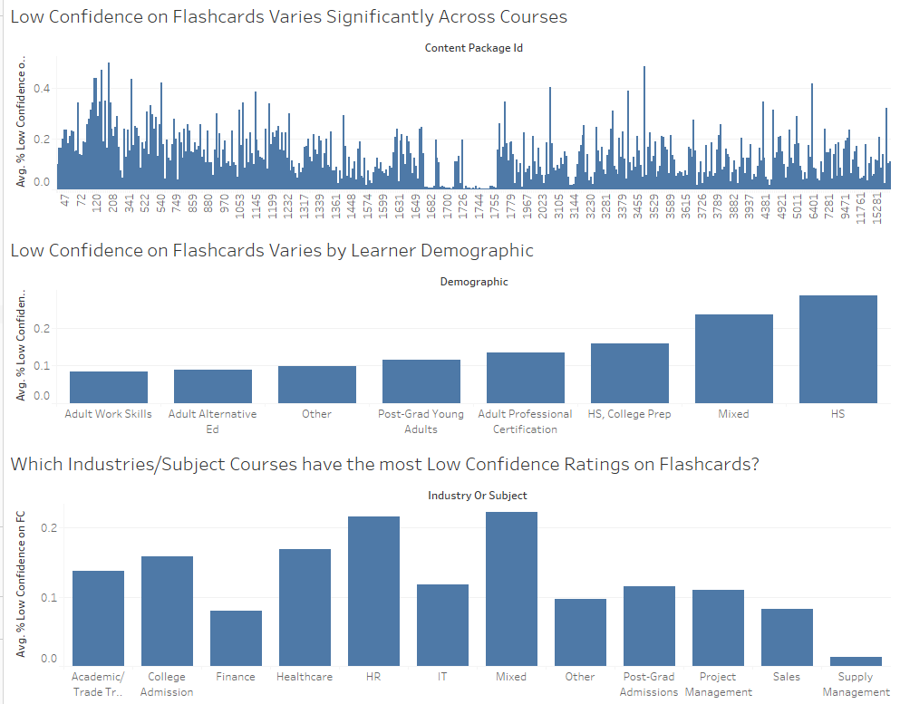
Notes:
Analyzing Flashcard Low Confidence by course topic and learner demographic reveals trends

Slide 26
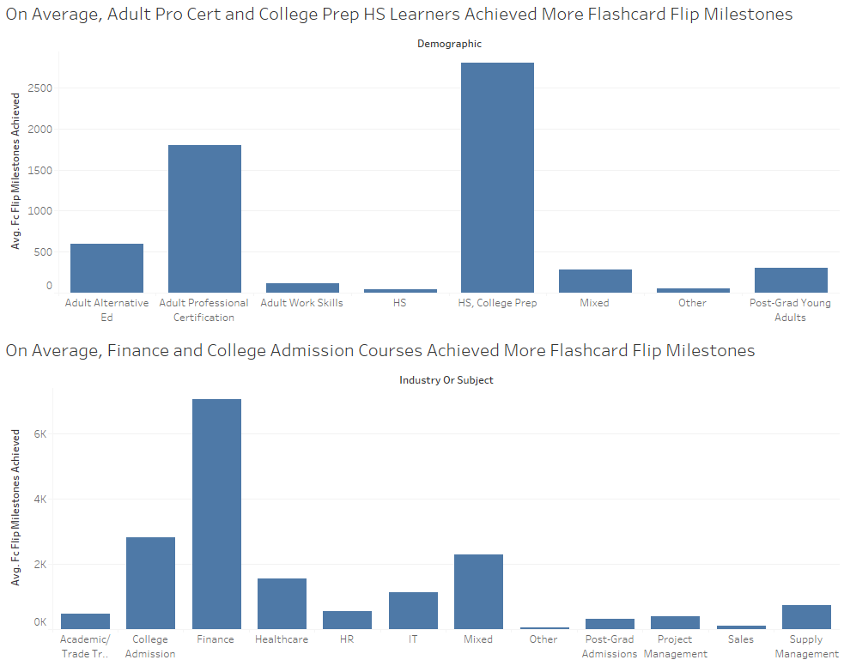
Notes:
Who Flips the Most Flashcards? Encourage Adult Pro Cert and HS, College Prep (demo) and finance and college admission (industry) customers to include flashcards in course design.

Slide 27
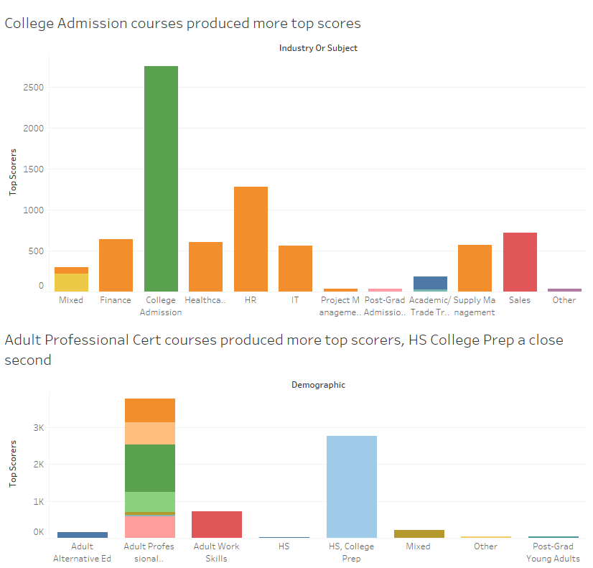
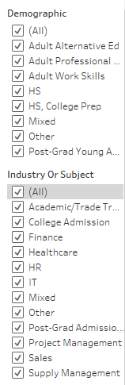
Notes:
College Admission produced more top scorers than any other industry, but the Adult Professional Certification learner demographic led in top scores

Slide 28
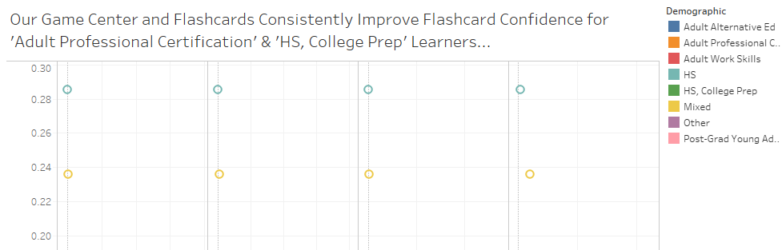
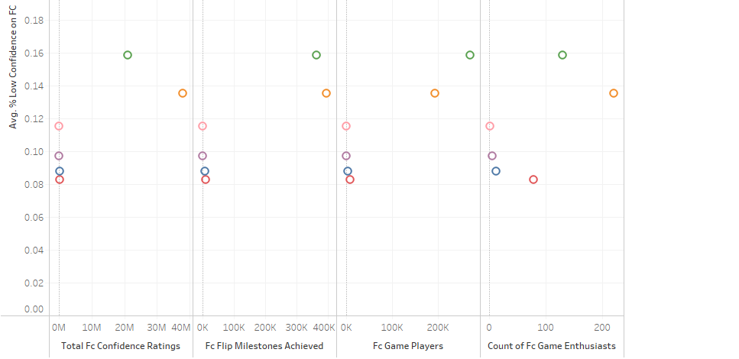
Notes:
Promote confidence ratings in HS and Mixed courses to get volume up and improve confidence. Promote success for HS College Prep and Adult Pro Cert. Look for X-factors for the other demographics

Slide 29
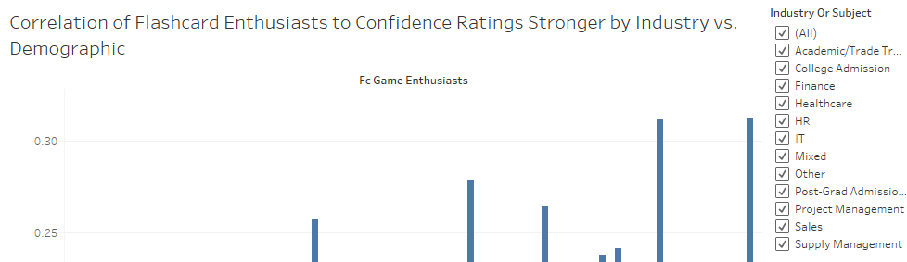
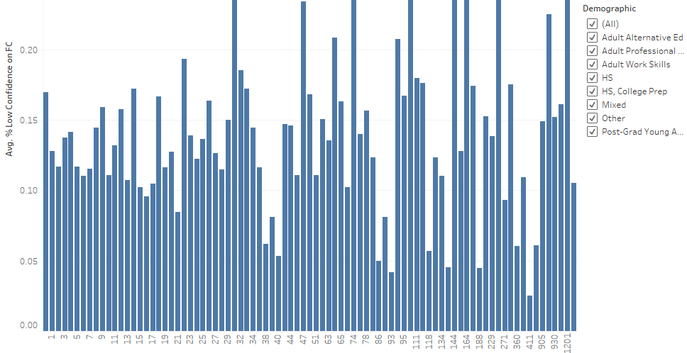
Notes:
Sales, Finance, Academic/Trade Training (industry), Adult Alternative Ed, and Adult Work Skills (demo) show flashcard enthusiasm benefiting learner flashcard confidence. Promote this correlation to these customers, and look for X-factors in the rest.

Slide 30
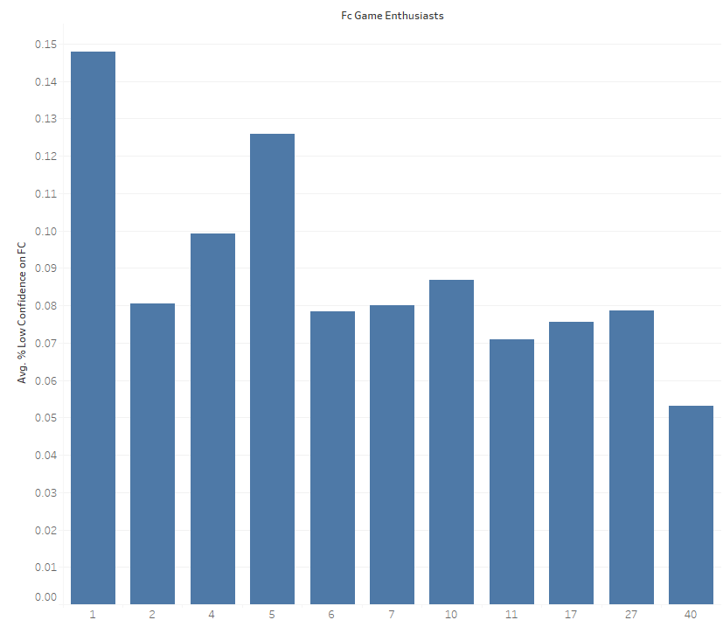
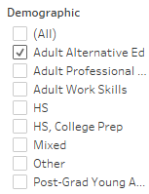
Notes:
Sales, Finance, Academic/Trade Training (industry), Adult Alternative Ed, and Adult Work Skills (demo) show flashcard enthusiasm benefiting learner flashcard confidence. Promote this correlation to these customers, and look for X-factors in the rest.

Slide 31
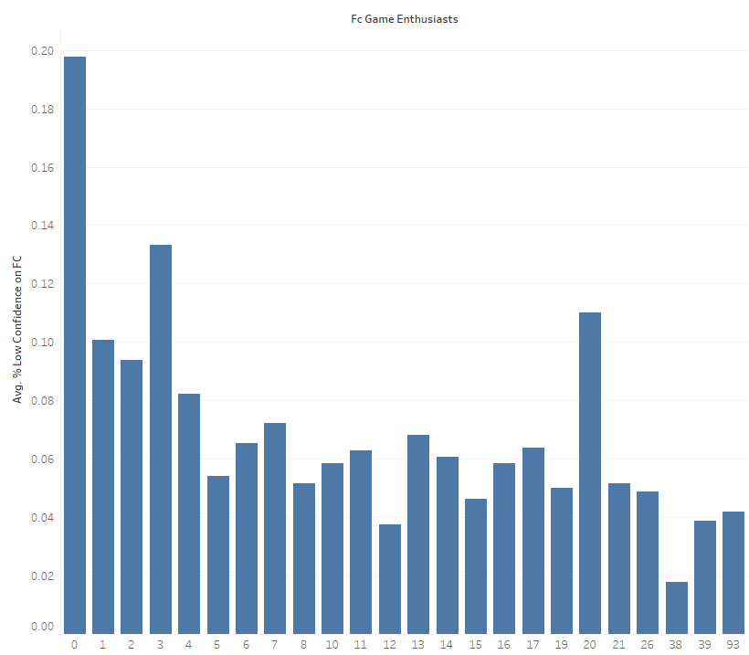
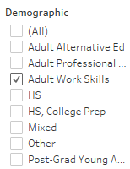
Notes:
Sales, Finance, Academic/Trade Training (industry), Adult Alternative Ed, and Adult Work Skills (demo) show flashcard enthusiasm benefiting learner flashcard confidence. Promote this correlation to these customers, and look for X-factors in the rest.

Slide 32
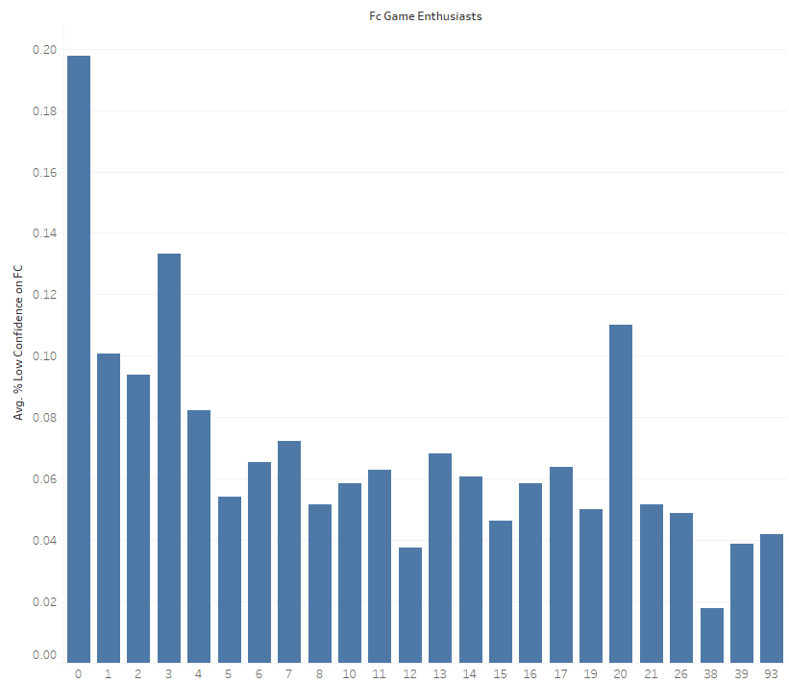

Notes:
Sales, Finance, Academic/Trade Training (industry), Adult Alternative Ed, and Adult Work Skills (demo) show flashcard enthusiasm benefiting learner flashcard confidence. Promote this correlation to these customers, and look for X-factors in the rest.

Slide 33
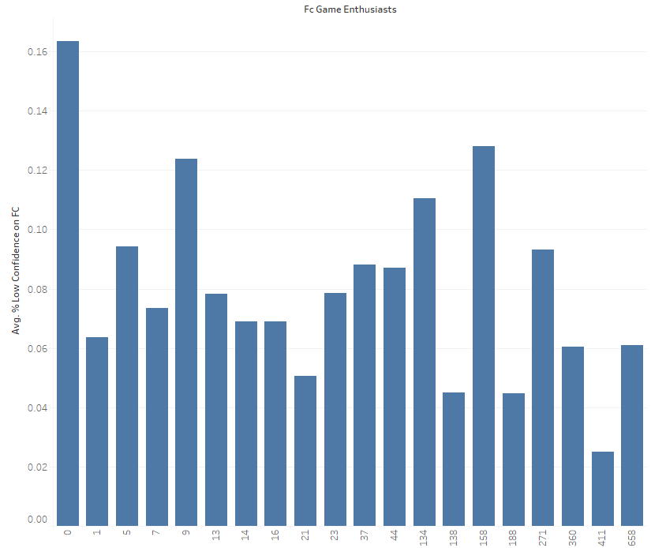

Notes:
Sales, Finance, Academic/Trade Training (industry), Adult Alternative Ed, and Adult Work Skills (demo) show flashcard enthusiasm benefiting learner flashcard confidence. Promote this correlation to these customers, and look for X-factors in the rest.

Slide 34
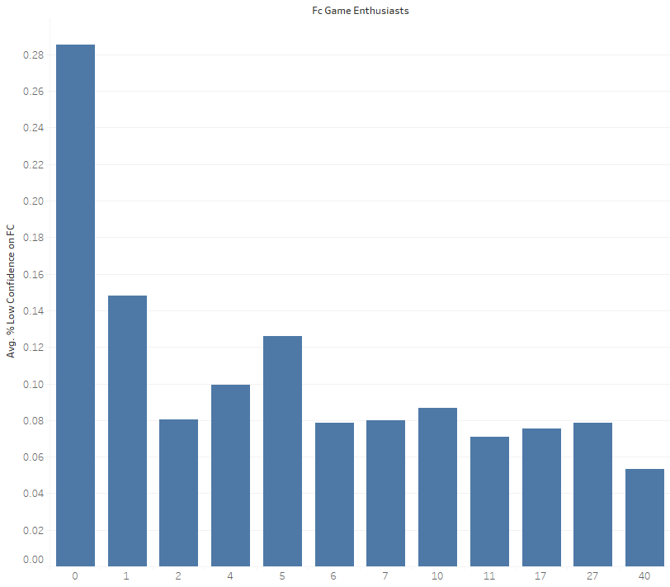

Notes:
Sales, Finance, Academic/Trade Training (industry), Adult Alternative Ed, and Adult Work Skills (demo) show flashcard enthusiasm benefiting learner flashcard confidence. Promote this correlation to these customers, and look for X-factors in the rest.

Slide 35
Recommendations & Next Steps?
Recommendations
Promote confidence ratings in HS and Mixed courses
Look for ways to connect playing multiple flashcard games to better confidence ratings on flashcards
Investigate
Next Steps
Investigate those courses with unusually large % low confidence ratings for their total Highscore counts.
Review the course with the outlier Highscore count on its flashcard games.
Compare flashcard confidence level to the ‘upper-tier’ game flip milestones.
Look more into causality of each flashcard game’s impact on confidence ratings
Compare confidence ratings in courses with different ‘Flashcard Addict’ vs. ‘Flashcard Player’ populations
I used between 400 and 600 courses for most of these analyses. I’d like to isolate those courses with the most user activity in each industry and demographic for at-scale findings.
Notes:
A few very enthusiastic game players could be interfering with data?

Slide 36
Appendix

Slide 37
Industry Terminology
CMS = Content Management System; In this case, a software-driven tool that allows users to CRUD digital learning content on behalf of the customer.
Flashcard = An interactive content item with a Side 1 view for a vocab term + a Side 2 term for a definition or explanation of the term
Game Center = An area of the course with different games a learner can play. Almost all games are powered by flashcards, though one is powered by questions.
Achievement = A “badge” awarded to a learner in a specific course when they meet certain content engagement requirements or complete certain activities in that course.
Highscore = A record created when a learner scores more points on a specific game than any prior player of that game in the course’s history (including themselves).
UI = User Interface; What a user interacts with to operate a tool
Real/Live learners/users = Individuals who have purchased a course to study its content to achieve a specific goal.
Launched course = A course that has been published for use by live learners to study and use its content.
Confidence level/rating = Selected by the learner, one of three options to describe how certain they are about their mastery of the topic/s addressed by the specific lesson, question, or flashcard they’ve been shown. Can be changed after initially selected, but the original rating is still recorded in the confidence_level table.
Low = I am not certain I understand/don’t understand this material.
Medium = I somewhat understand/understand part of this material.
High = I am certain I understand this material.

